Slide 1
On-Policy Deep Reinforcement Learning for the Average-Reward Criterion
E1-227 Reinforcement Learning
PROJECT PRESENTATION
Zhang, Y. and Ross, K.W., 2021, July. On-policy deep reinforcement learning for the average-reward criterion. In International Conference on Machine Learning (pp. 12535-12545). PMLR.
Abhijeet A T (21067)
Abhishek Dhar (21368)
Aravind S (21690)

Slide 2
OUTLINE
Motivation
Introduction
Preliminaries
Main Results
Practical Algorithm
Results and Our Work
Conclusion
References

Slide 3
MOTIVATION
Discounted reward weighs immediate rewards more than long-run rewards
This is well suited for episodic tasks but not continuous control tasks
The average reward criterion weighs all rewards equally and hence is better suited for continuous control tasks

Slide 4
INTRODUCTION
Most DRL literature focuses on discounted rewards.
This paper derives a novel bound that depends on the average divergence between two policies and Kemeny’s constant.
Based on the bound, the authors propose an iterative procedure that produces a sequence of monotonically improved policies for the average reward criterion.

Slide 5
PRELIMINARIES

Slide 6
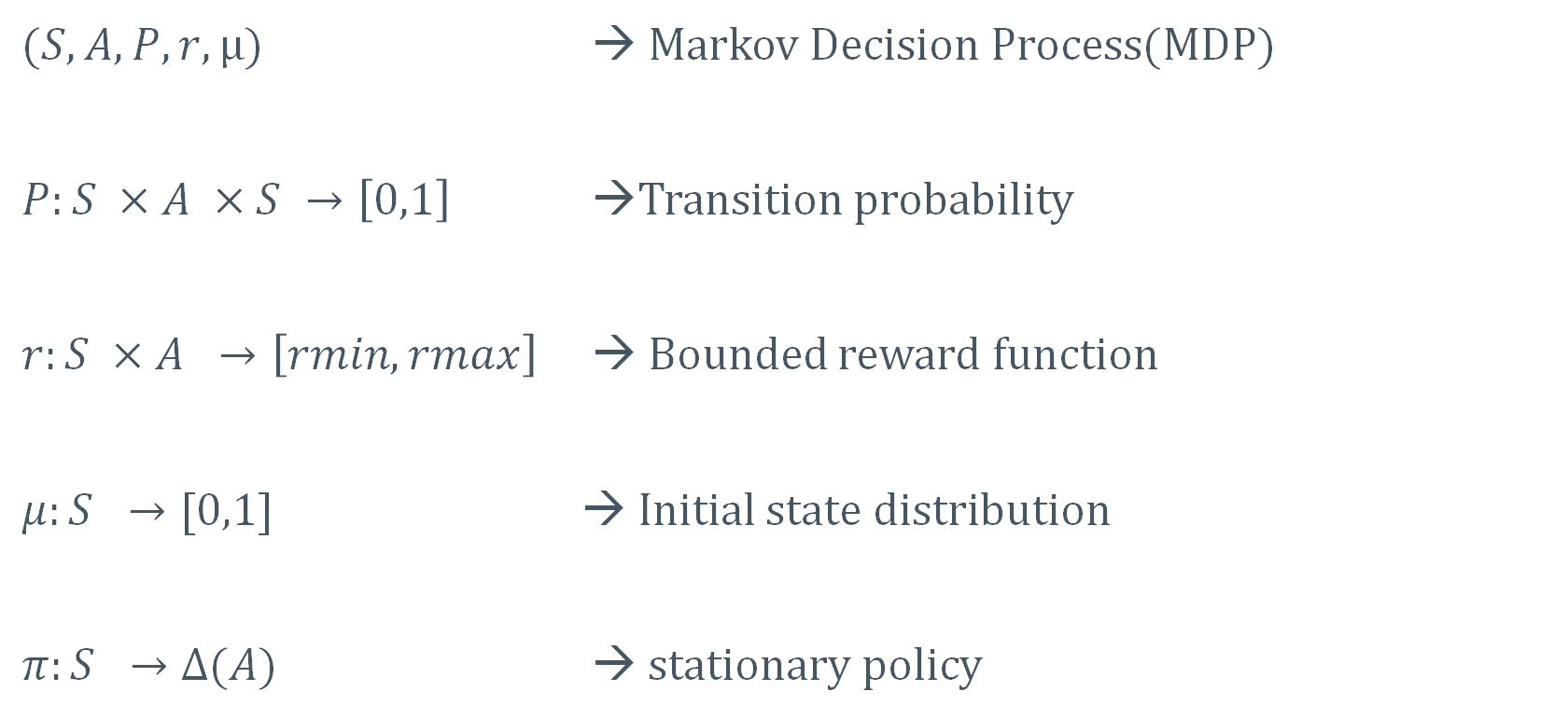
NOTATIONS
$(S,A,P,r,μ)$ → Markov Decision Process(MDP)
$P:S ×A ×S →\left[0,1\right]$ →Transition probability
$r:S ×A →\left[rmin,rmax\right]$ → Bounded reward function
$μ:S →[0,1]$ → Initial state distribution
$π:S →Δ(A)$ → stationary policy

Slide 7
ASSUMPTIONS
Assumption 1 - (Ergodic):
For every stationary policy, the induced Markov chain is irreducible and aperiodic.
Assumption 2 - (Aperiodic Unichain):
For every stationary policy, the induced Markov chain contains a single aperiodic recurrent class and a finite but possibly empty set of transient states.

Slide 8
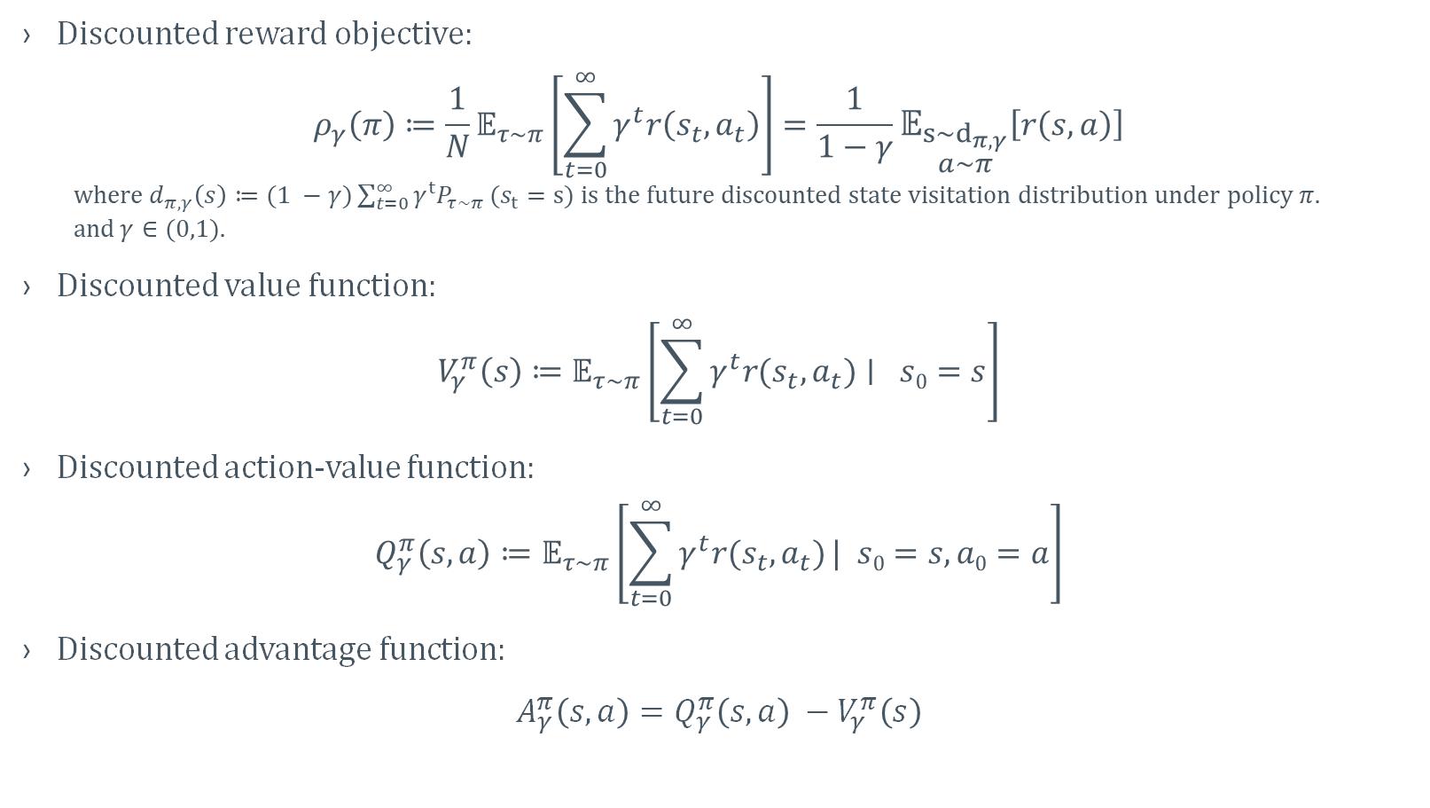
DISCOUNTED REWARD CRITERION
Discounted reward objective:
$$ρ_{γ}\left(π\right)≔\frac{1}{N}𝔼_{τ\sim π}\left[\sum_{t=0}^{∞}{γ^{t}r\left(s_{t}, a_{t}\right)}\right]=\frac{1}{1−γ}𝔼_{\begin{matrix}s\sim d_{π,γ} \\ a\sim π\end{matrix}}\left[r\left(s,a\right)\right]$$
where $d_{π,γ}\left(s\right)≔(1 −γ)\sum_{t=0}^{∞}{γ^{t}P_{τ\sim π}}(s_{t}=s)$is the future discounted state visitation distribution under policy $π.$
and$γ∈(0,1)$.
Discounted value function:
$$V_{γ}^{π}\left(s\right)≔𝔼_{τ\sim π}\left[\sum_{t=0}^{∞}{γ^{t}r(s_{t}, a_{t})}∣ s0=s\right]$$
Discounted action-value function:
$$Q_{γ}^{π}\left(s,a\right)≔𝔼_{τ\sim π}\left[\sum_{t=0}^{∞}{γ^{t}r(s_{t}, a_{t})}| s0=s,a0=a\right]$$
Discounted advantage function:
$A_{γ}^{π}\left(s,a\right)=Q_{γ}^{π}\left(s,a\right) −$ $V_{γ}^{π}\left(s\right)$

Slide 9
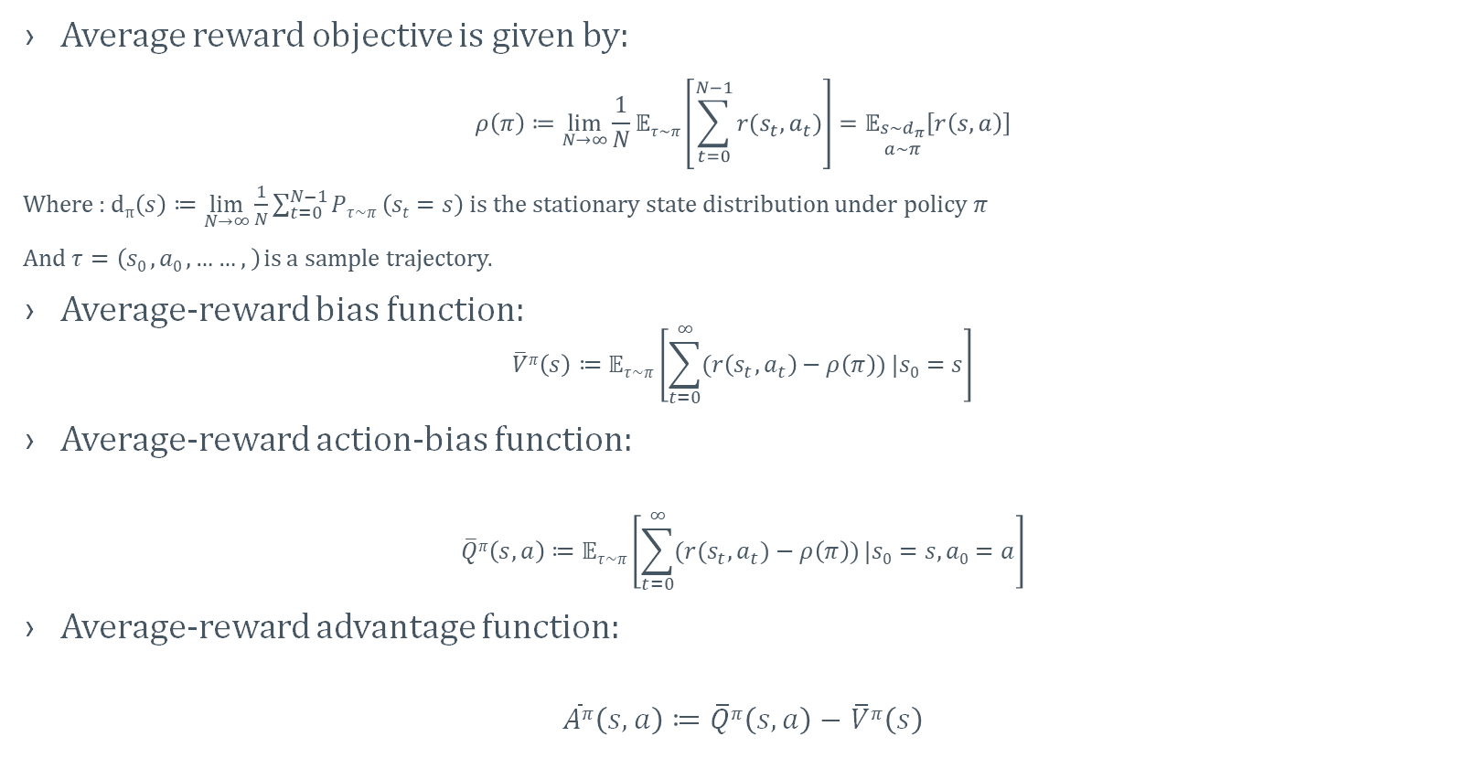
AVERAGE REWARD CRITERION
Average reward objective is given by:
$$ρ\left(π\right)≔\lim_{N→∞}{\frac{1}{N}𝔼τ\sim π\left[\sum_{t=0}^{N−1}{r(s_{t},a_{t})}\right]}=𝔼_{\begin{matrix}s\sim d_{π} \\ a\sim π\end{matrix}}\left[r\left(s,a\right)\right]$$
Where : d$π\left(s\right)≔\lim_{N→∞}{\frac{1}{N}\sum_{t=0}^{N−1}{Pτ\sim π}\left(st=s\right)}$ is the stationary state distribution under policy $π$
And $τ=\left(s0 ,a0 ,……,\right)$ is a sample trajectory.
Average-reward bias function:
$$\overline{V}π\left(s\right)≔𝔼τ\sim π\left[\sum_{t=0}^{∞}{(r\left(s_{t},a_{t}\right)−ρ\left(π\right))}|s0=s\right]$$
Average-reward action-bias function:
$$\overline{Q}π\left(s,a\right)≔𝔼τ\sim π\left[\sum_{t=0}^{∞}{(r(s_{t},a_{t})−ρ\left(π\right))}|s0=s,a0=a\right]$$
Average-reward advantage function:
$$\overline{A}π\left(s,a\right)≔\overline{Q}π\left(s,a\right)−\overline{V}π\left(s\right)$$

Slide 10
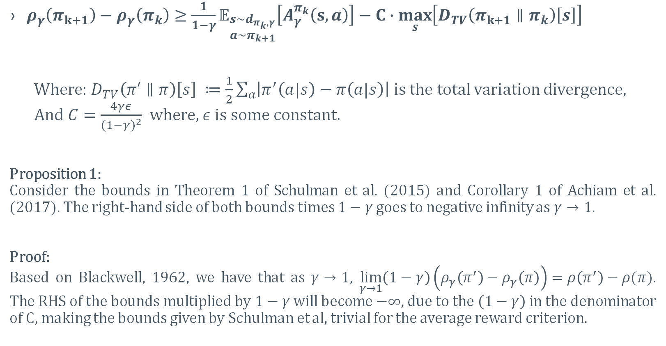
MONOTONICALLY IMPROVEMENT GUARANTEES FOR DISCOUNTED RL
$ρ_{γ}\left(π_{k+1}\right)−ρ_{γ}\left(π_{k}\right)≥\frac{1}{1−γ}𝔼_{\begin{matrix}s\sim d_{π_{k},γ} \\ a\sim π_{k+1}\end{matrix}}\left[A_{γ}^{π_{k}}\left(s,a\right)\right]−C∙\max_{s}\left[D_{TV}\left(π_{k+1}∥π_{k}\right)\left[s\right]\right]$
Where: $D_{TV}\left(π′∥π\right)\left[s\right] ≔\frac{1}{2}\sum_{a}{\left|π^{′}\left(a|s\right)−π\left(a|s\right)\right|}$ is the total variation divergence, And $C=\frac{4γε}{{(1−γ)}^{2}}$ where, $ε$ is some constant.
Proposition 1:
Consider the bounds in Theorem 1 of Schulman et al. (2015) and Corollary 1 of Achiam et al. (2017). The right-hand side of both bounds times $1−γ$ goes to negative infinity as $γ→1$.
Proof:
Based on Blackwell, 1962, we have that as $γ→1$, $\lim_{γ→1}\left(1−γ\right)\left(ρ_{γ}\left(π^{′}\right)−ρ_{γ}\left(π\right)\right)=ρ\left(π^{′}\right)−ρ(π)$. The RHS of the bounds multiplied by $1−γ$ will become $−∞$, due to the $\left(1−γ\right)$in the denominator of C, making the bounds given by Schulman et al, trivial for the average reward criterion.

Slide 11
MAIN RESULTS

Slide 12
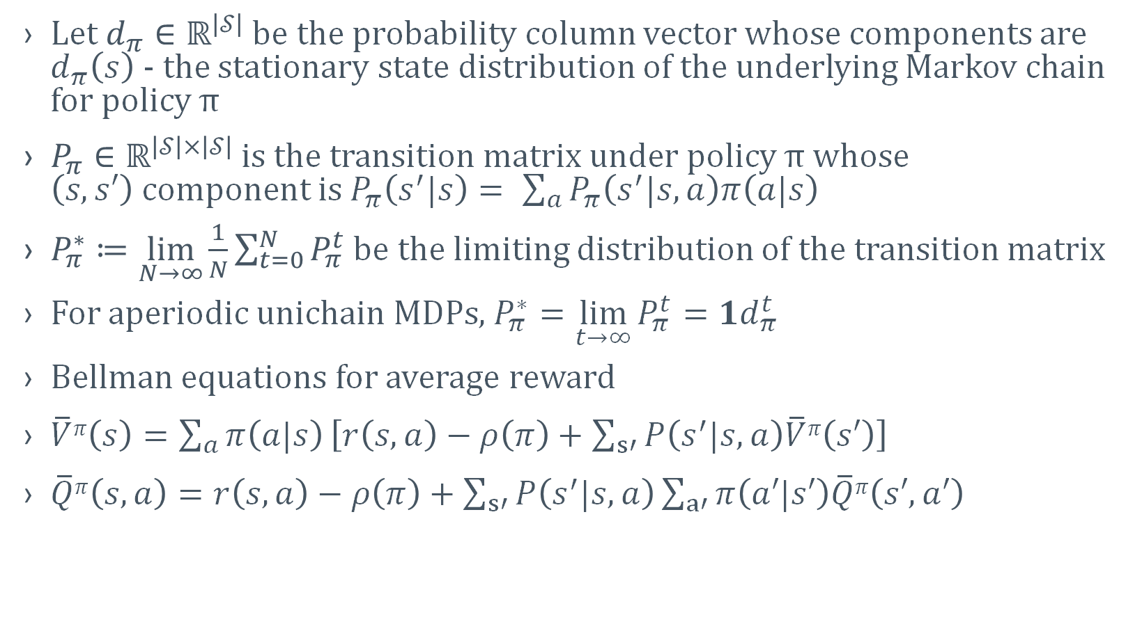
NOTATIONS
Let $d_{π}∈ℝ^{\left|𝒮\right|}$ be the probability column vector whose components are $d_{π}\left(s\right)$ - the stationary state distribution of the underlying Markov chain for policy π
$P_{π}∈ℝ^{\left|𝒮\right|×\left|𝒮\right|}$ is the transition matrix under policy π whose $\left(s,s′\right)$component is $P_{π}\left(s^{′}|s\right)= \sum_{a}{P_{π}\left(s^{′}|s,a\right)π\left(a|s\right)}$
$P_{π}^{∗}≔\lim_{N→∞}{\frac{1}{N}\sum_{t=0}^{N}{P_{π}^{t}}}$be the limiting distribution of the transition matrix
For aperiodic unichain MDPs, $P_{π}^{∗}=\lim_{t→∞}{P_{π}^{t}}=1d_{π}^{t}$
Bellman equations for average reward
$\overline{V}π\left(s\right)=\sum_{a}{π\left(a|s\right)}\left[r\left(s, a\right)−ρ\left(π\right)+\sum_{s′}{P\left(s^{′}|s,a\right)\overline{V}π\left(s′\right)}\right]$
$\overline{Q}π\left(s,a\right)=r\left(s, a\right)−ρ\left(π\right)+\sum_{s′}{P\left(s^{′}|s,a\right)}\sum_{a′}{π\left(a′|s′\right)\overline{Q}π\left(s′,a′\right) }$

Slide 13

AVERAGE REWARD POLICY IMRPOVEMENT THEOREM
Lemma 1
Under Assumption 2 we have,
$ρ\left(π^{′}\right)−ρ\left(π\right){=𝔼}_{\begin{matrix}s\sim d_{π^{′}} \\ a\sim π^{′}\end{matrix}}\left[ \overline{A}π\left(s,a\right)\right]$
for any two stochastic policies $π$and $π^{′}.$
Proof:
Expanding the right-hand side
$$𝔼_{\begin{matrix}s\sim d_{π^{′}} \\ a\sim π^{′}\end{matrix}} \left[ \overline{A}π(s,a)\right]=𝔼_{\begin{matrix}s\sim d_{π^{′}} \\ a\sim π^{′}\end{matrix}}\left[\overline{Q}π\left(s,a\right)−\overline{V}π\left(s\right)\right]$$
$=𝔼_{\begin{matrix}s\sim d_{π^{′}} \\ a\sim π^{′}\end{matrix}}\left[r\left(s, a\right)−ρ\left(π\right)+𝔼_{s^{′}\sim P(∙|s,a)}\left[\overline{V}π\left(s′\right)\right]−\overline{V}π\left(s\right)\right]$
$=ρ\left(π′\right) −ρ\left(π\right)+𝔼_{\begin{matrix}s\sim d_{π^{′}} \\ a\sim π^{′} \\ s^{′}\sim P\left(∙ | s,a\right)\end{matrix}}\left[\overline{V}π\left(s^{′}\right)\right]−𝔼_{s\sim d_{π^{′}}}\left[\overline{V}π\left(s\right)\right]$
Since $d_{π′}\left(s\right)$ is the stationary distribution:
$𝔼_{\begin{matrix}s\sim d_{π^{′}} \\ a\sim π^{′} \\ s^{′}\sim P\left(∙ | s,a\right)\end{matrix}} \left[\overline{V}π\left(s′\right)\right]−𝔼_{s\sim d_{π^{′}}}\left[\overline{V}π\left(s\right)\right]=0$
Which gives the desired result

Slide 14
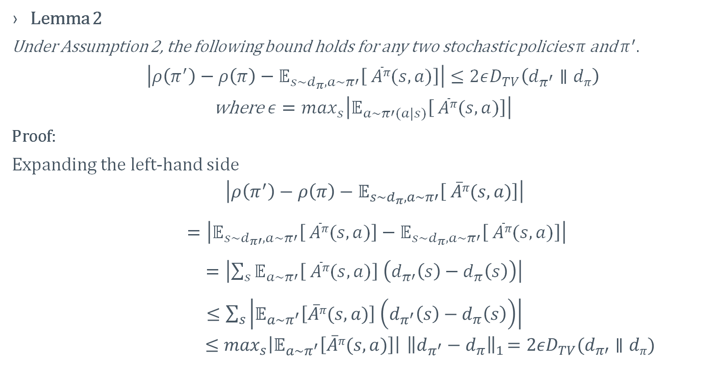
AVERAGE REWARD POLICY IMRPOVEMENT THEOREM
Lemma 2
Under Assumption 2, the following bound holds for any two stochastic policies $π$and $π^{′}.$
$\left|ρ\left(π^{′}\right)−ρ\left(π\right)−𝔼_{s\sim d_{π},a\sim π′}\left[ \overline{A}π(s,a)\right]\right|≤2εD_{TV}\left(d_{π^{′}}∥dπ\right)$
where $ε=\max_{s}\left|𝔼_{a\sim π′(a|s)}\left[ \overline{A}π(s,a)\right]\right|$
Proof:
Expanding the left-hand side
$$\left|ρ\left(π^{′}\right)−ρ\left(π\right)−𝔼_{s\sim d_{π},a\sim π′}\left[ \overline{A}π(s,a)\right]\right|$$
$=\left|𝔼_{s\sim d_{π′},a\sim π′}\left[ \overline{A}π(s,a)\right]−𝔼_{s\sim d_{π},a\sim π′}\left[ \overline{A}π(s,a)\right]\right|$
$=\left|\sum_{s}{𝔼_{a\sim π′}\left[ \overline{A}π(s,a)\right] \left(d_{π′}\left(s\right)−d_{π}\left(s\right)\right)}\right|$
$≤\sum_{s}{\left|𝔼_{a\sim π^{′}}\left[\overline{A}π(s,a)\right] \left(d_{π^{′}}\left(s\right)−d_{π}\left(s\right)\right)\right|}$
$$≤\max_{s}\left|𝔼_{a\sim π^{′}}\left[\overline{A}π(s,a)\right]\right|{ \left\|d_{π^{′}}−d_{π}\right\|}_{1}=2εD_{TV}(d_{π′}∥dπ)$$

Slide 15
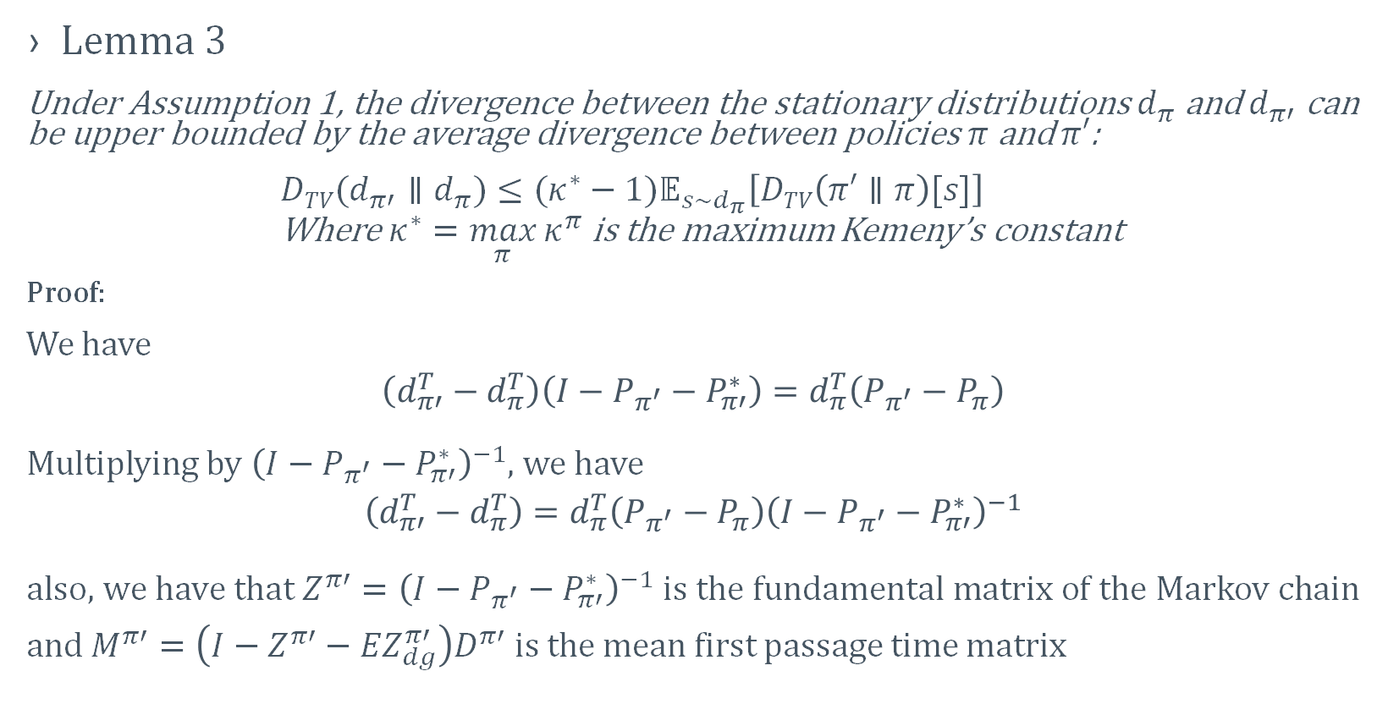
AVERAGE REWARD POLICY IMRPOVEMENT THEOREM
Lemma 3
Under Assumption 1, the divergence between the stationary distributions $d_{π}$ and $d_{π′}$ can be upper bounded by the average divergence between policies $π$ and $π′$:
$DTV(d_{π′}∥d_{π})≤(κ^{∗}−1)𝔼_{s\sim d_{π}}\left[DTV\left(π′∥π\right)[s]\right]$
Where $κ^{∗}=\max_{π}{κ^{π}}$ is the maximum Kemeny’s constant
Proof:
We have
$$\left(d_{π′}^{T}−d_{π}^{T}\right)\left(I−P_{π^{′}}−P_{π′}^{∗}\right)=d_{π}^{T}\left(P_{π^{′}}−P_{π}\right)$$
Multiplying by ${\left(I−P_{π^{′}}−P_{π′}^{∗}\right)}^{−1}$, we have
$$\left(d_{π′}^{T}−d_{π}^{T}\right)=d_{π}^{T}\left(P_{π^{′}}−P_{π}\right){\left(I−P_{π^{′}}−P_{π′}^{∗}\right)}^{−1}$$ $\text{also}\text{, }\text{we} \text{have} \text{that} {Z^{π′}=\left(I−P_{π^{′}}−P_{π′}^{∗}\right)}^{−1} is$ the fundamental matrix of the Markov chain $\text{and} M^{π′}=\left(I−Z^{π′}−{EZ}_{dg}^{π′}\right)D^{π′} is the$ mean first passage time matrix

Slide 16
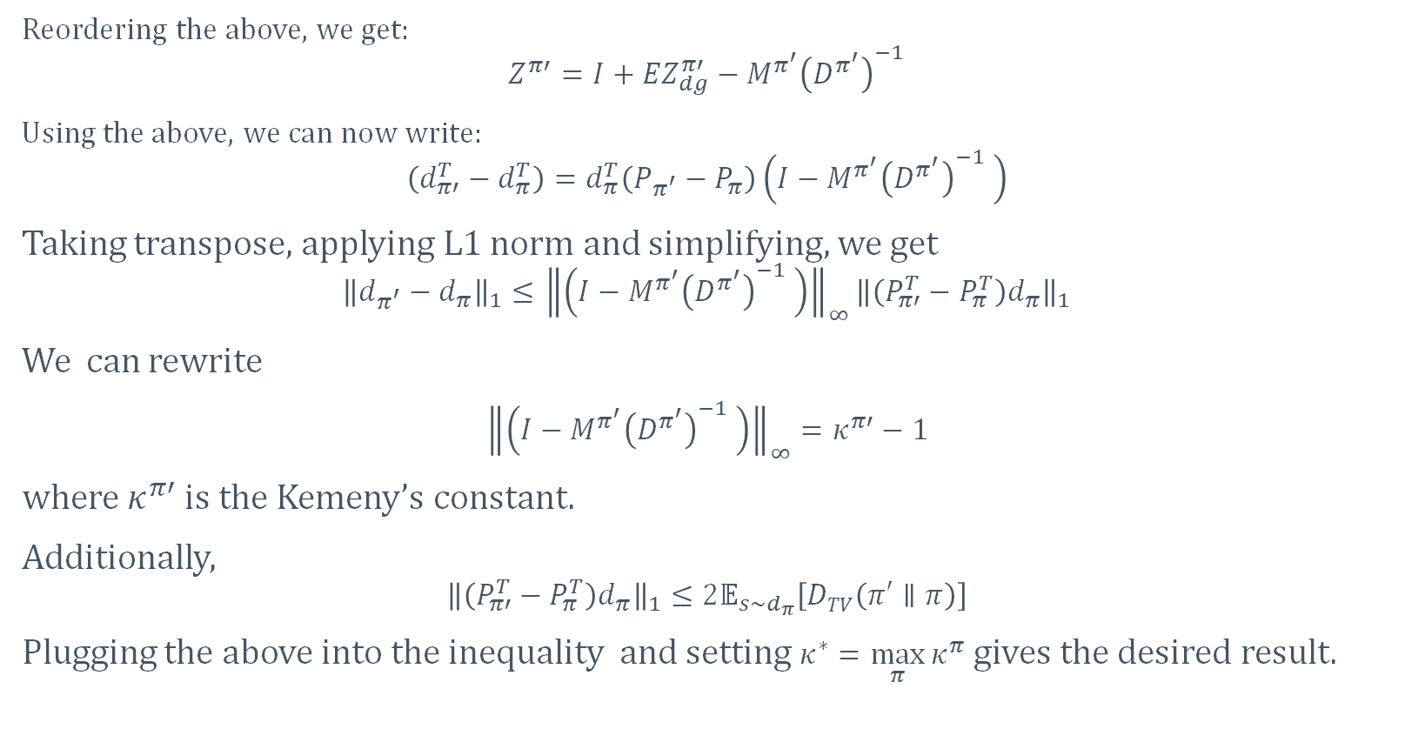
AVERAGE REWARD POLICY IMRPOVEMENT THEOREM
Reordering the above, we get:
$$Z^{π′}=I+{EZ}_{dg}^{π′}−M^{π^{′}}{\left(D^{π^{′}}\right)}^{−1}$$
Using the above, we can now write:
$$\left(d_{π′}^{T}−d_{π}^{T}\right)=d_{π}^{T}\left(P_{π^{′}}−P_{π}\right)\left(I−M^{π^{′}}{\left(D^{π^{′}}\right)}^{−1} \right)$$
Taking transpose, applying L1 norm and simplifying, we get
$${\left\|d_{π^{′}}−d_{π}\right\|}_{1}≤{\left\|\left(I−M^{π^{′}}{\left(D^{π^{′}}\right)}^{−1} \right)\right\|}_{∞}{\left\|\left(P_{π′}^{T}−P_{π}^{T}\right)d_{π}\right\|}_{1}$$
We can rewrite
${\left\|\left(I−M^{π^{′}}{\left(D^{π^{′}}\right)}^{−1} \right)\right\|}_{∞}=κ^{π′}−1$
where $κ^{π′}$ is the Kemeny’s constant.
Additionally,
$${\left\|\left(P_{π′}^{T}−P_{π}^{T}\right)d_{π}\right\|}_{1}≤2𝔼_{s\sim d_{π}}\left[DTV\left(π′∥π\right)\right]$$
Plugging the above into the inequality and setting $κ^{∗}=\max_{π}{κ^{π}}$ gives the desired result.

Slide 17
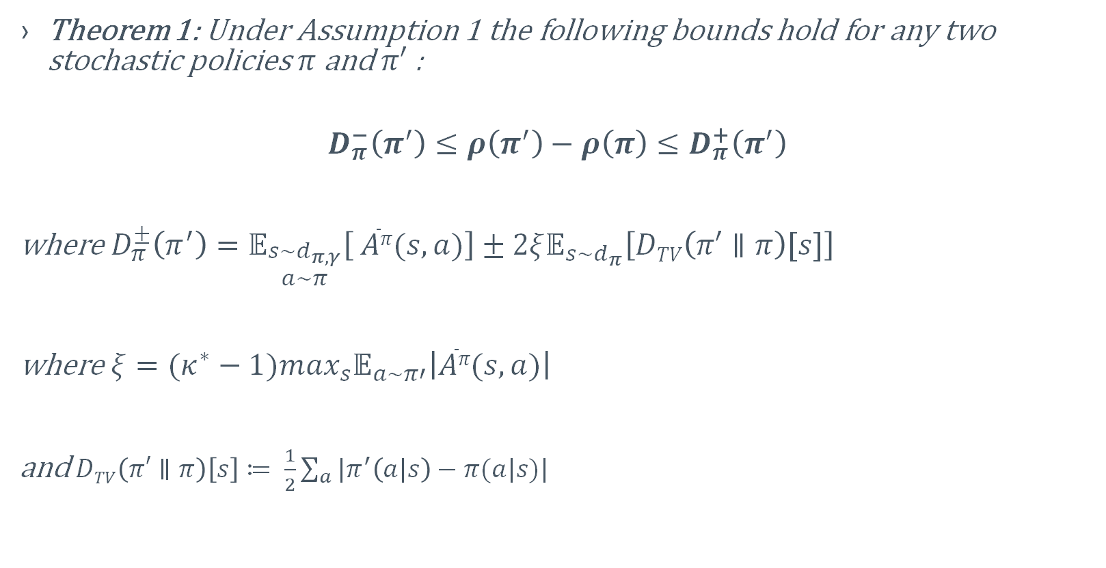
AVERAGE REWARD POLICY IMRPOVEMENT THEOREM
Theorem 1: Under Assumption 1 the following bounds hold for any two stochastic policies $π$ and $π′$ :
$$D_{π}^{−}\left(π^{′}\right)≤ρ\left(π^{′}\right)−ρ\left(π\right)≤D_{π}^{+}\left(π^{′}\right)$$
where $D_{π}^{±}\left(π^{′}\right)=𝔼_{\begin{matrix}s\sim d_{π,γ} \\ a\sim π\end{matrix}}\left[ \overline{A}π(s,a)\right]±2ξ𝔼_{s\sim d_{π}}\left[DTV\left(π′∥π\right)[s]\right]$
where $ξ=(κ^{∗}−1)\max_{s}𝔼_{a\sim π′}\left|\overline{A}π(s,a)\right|$
and $DTV\left(π′∥π\right)\left[s\right]≔ \frac{1}{2}\sum_{a}{|π^{′}\left(a|s\right)−π(a|s)|}$

Slide 18
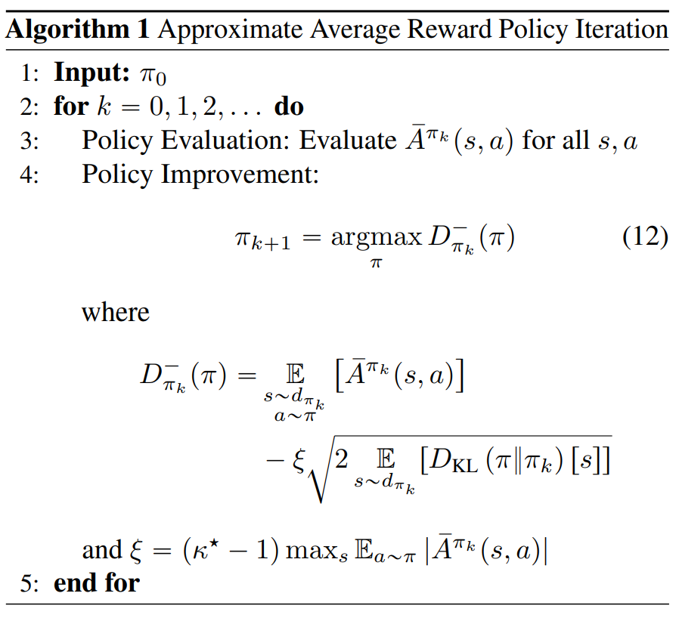
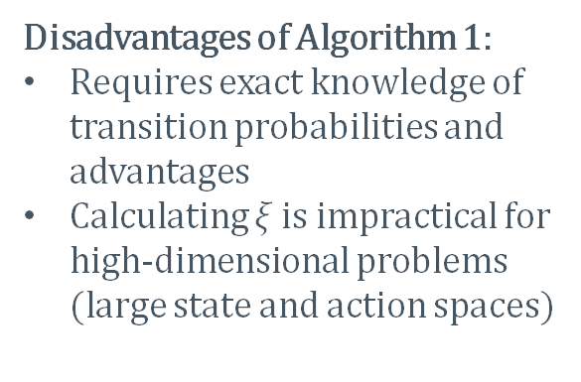
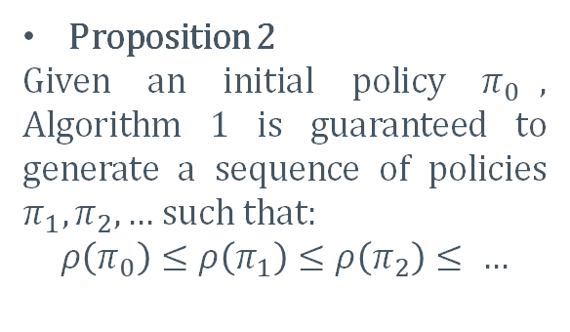
Approximate average reward policy iteration
Proposition 2
Given an initial policy $π_{0}$, Algorithm 1 is guaranteed to generate a sequence of policies $π_{1}, π_{2},…$ such that:
$$ρ\left(π_{0}\right)≤ρ\left(π_{1}\right)≤ρ\left(π_{2}\right)≤ …$$
Disadvantages of Algorithm 1:
Requires exact knowledge of transition probabilities and advantages
Calculating $ξ$ is impractical for high-dimensional problems (large state and action spaces)

Slide 19
PRACTICAL ALGORITHM

Slide 20
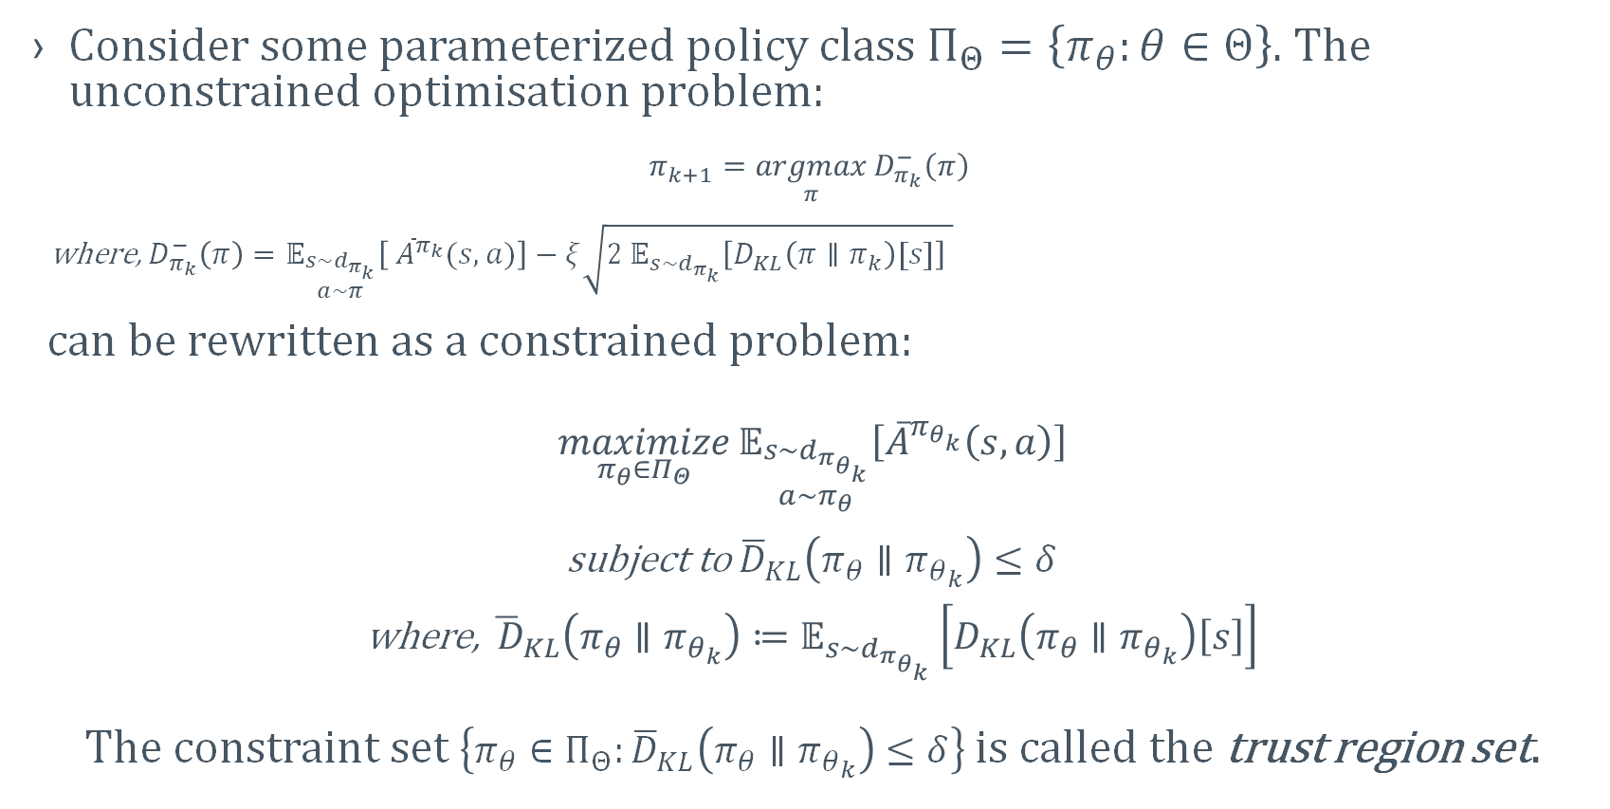
AVERAGE REWARD TRUST REGION METHODS
Consider some parameterized policy class $Π_{Θ}=\left\{π_{θ}:θ∈Θ\right\}$. The unconstrained optimisation problem:
$$π_{k+1}=\underset{π}{argmax}{D_{π_{k}}^{−}\left(π\right) }$$
where, $D_{π_{k}}^{−}\left(π\right)=𝔼_{\begin{matrix}s\sim d_{π_{k}} \\ a\sim π\end{matrix}}\left[ {\overline{A}}^{π_{k}}(s,a)\right]−ξ\sqrt{{2 𝔼}_{s\sim d_{π_{k}}}\left[D_{KL}\left(π∥π_{k}\right)[s]\right] }$
can be rewritten as a constrained problem:
$$\underset{π_{θ}{∈Π}_{Θ}}{maximize}{𝔼_{\begin{matrix}s\sim d_{π_{θ_{k}}} \\ a\sim π_{θ}\end{matrix}}\left[{\overline{A}}^{π_{θ_{k}}}\left(s,a\right)\right]}$$
subject to ${\overline{D}}_{KL}\left(π_{θ}∥π_{θ_{k}}\right)≤δ$
where, ${\overline{ D}}_{KL}\left(π_{θ}∥π_{θ_{k}}\right)≔𝔼_{s\sim d_{π_{θ_{k}}}}\left[D_{KL}\left(π_{θ}∥π_{θ_{k}}\right)\left[s\right]\right]$
The constraint set $\left\{π_{θ}∈Π_{Θ}:{\overline{D}}_{KL}\left(π_{θ}∥π_{θ_{k}}\right)≤δ\right\}$ is called the trust region set.

Slide 21
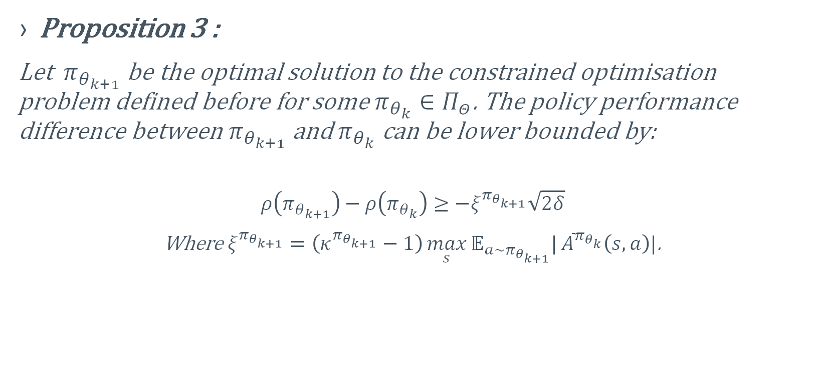
AVERAGE REWARD TRUST REGION METHODS
Proposition 3 :
Let${ π}_{θ_{k+1}}$be the optimal solution to the constrained optimisation problem defined before for some $π_{θ_{k}}∈Π_{Θ}$. The policy performance difference between $π_{θ_{k+1}}$and $π_{θ_{k}}$ can be lower bounded by:
$$ρ\left(π_{θ_{k+1}}\right)−ρ\left(π_{θ_{k}}\right)≥−ξ^{π_{θ_{k+1}}}\sqrt{2δ}$$
Where $ξ^{π_{θ_{k+1}}}=\left(κ^{π_{θ_{k+1}}}−1\right)\max_{s}{𝔼_{a\sim π_{θ_{k+1}}}|}{\overline{A}}^{π_{θ_{k}}}\left(s,a\right)|$.
Notes:
worst-case performance degradation guarantee

Slide 22
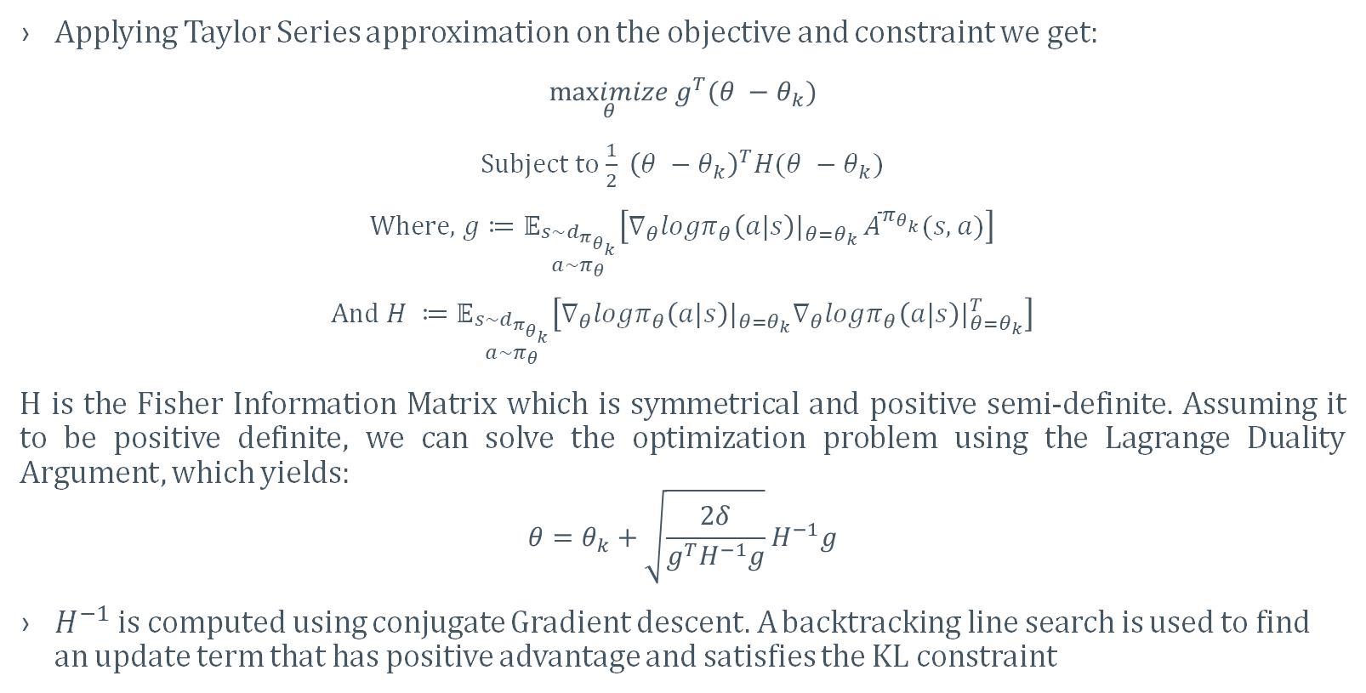
AVERAGE REWARD TRPO (ATRPO)
Applying Taylor Series approximation on the objective and constraint we get:
$$\underset{θ}{maximize}{g^{T}(θ −θ_{k})}$$
Subject to $\frac{1}{2} {\left(θ −θ_{k}\right)}^{T}H(θ −θ_{k})$
Where, $g≔𝔼_{\begin{matrix}s\sim d_{π_{θ_{k}}} \\ a\sim π_{θ}\end{matrix}}\left[∇_{θ}logπ_{θ}\left(a|s\right)|_{θ=θ_{k}} {\overline{A}}^{π_{θ_{k}}}(s,a)\right]$
And $H ≔𝔼_{\begin{matrix}s\sim d_{π_{θ_{k}}} \\ a\sim π_{θ}\end{matrix}}\left[∇_{θ}logπ_{θ}\left(a|s\right)|_{θ=θ_{k}}∇_{θ}logπ_{θ}\left(a|s\right)|_{θ=θ_{k}}^{T}\right]$
H is the Fisher Information Matrix which is symmetrical and positive semi-definite. Assuming it to be positive definite, we can solve the optimization problem using the Lagrange Duality Argument, which yields:
$$θ=θ_{k}+\sqrt{\frac{2δ}{g^{T}H^{−1}g}}H^{−1}g$$
$H^{−1}$is computed using conjugate Gradient descent. A backtracking line search is used to find an update term that has positive advantage and satisfies the KL constraint

Slide 23
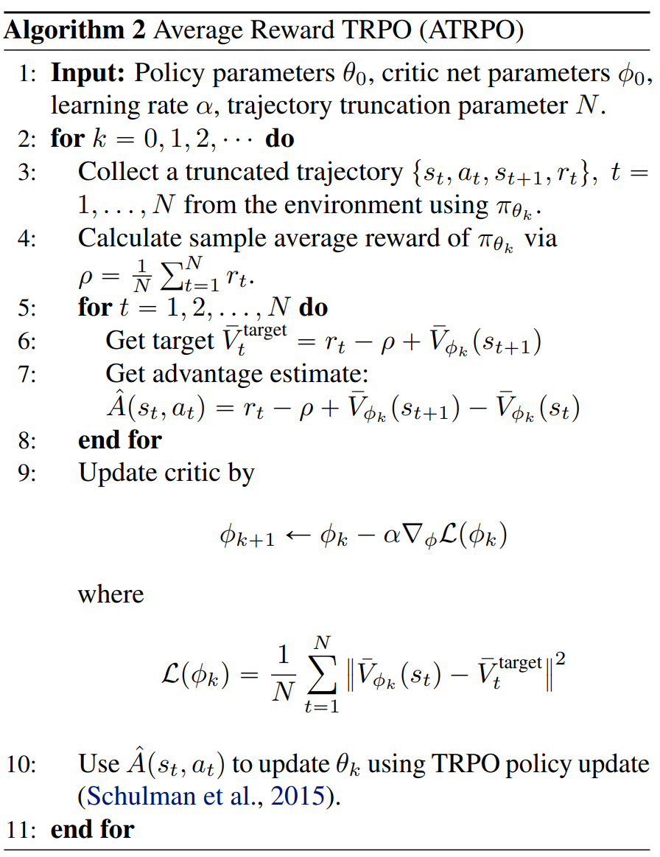
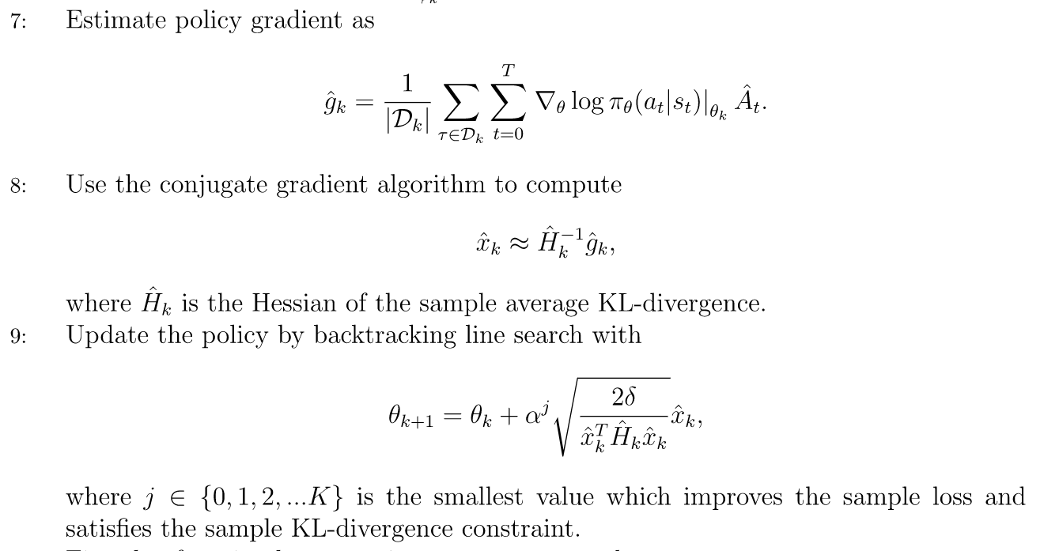
AVERAGE REWARD TRPO ALGORITHM (ATRPO)
TRPO policy update

Slide 24
RESULTS

Slide 25
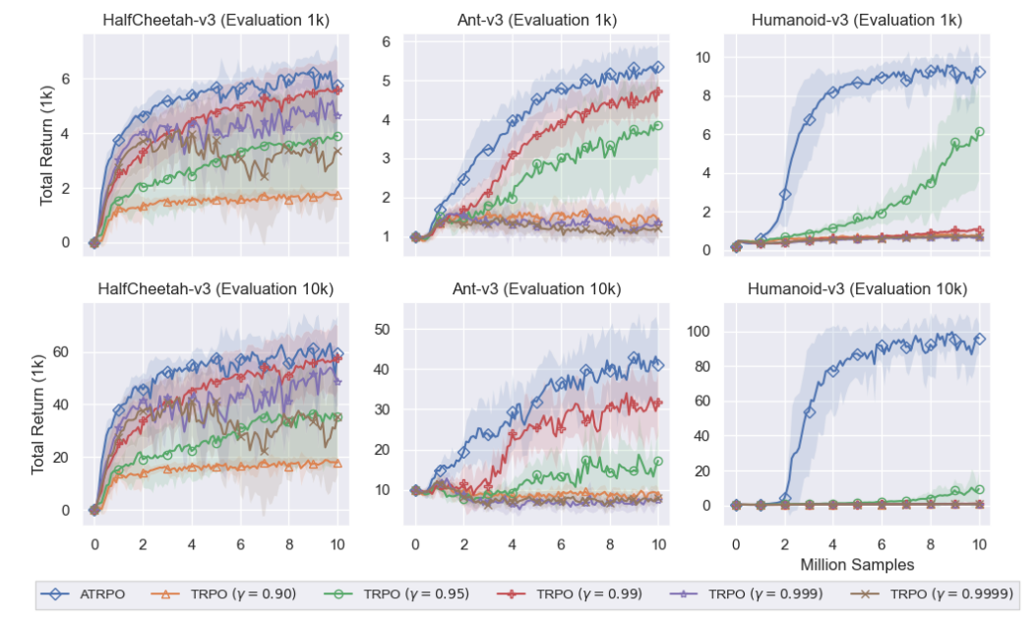
EVALUATION PROTOCOL:
A policy was trained for 10 million environment steps. Every 100,000 steps, 10 separate evaluation trajectories were run with the current policy without exploration. For each evaluation trajectory the undiscounted return of the trajectory until the agent falls or until 1,000 steps, whichever comes first, were calculated.
Notes:
Talk about reset and cost as ATRPO assumes continuous control

Slide 26
RESULTS – OUR WORK

Slide 27
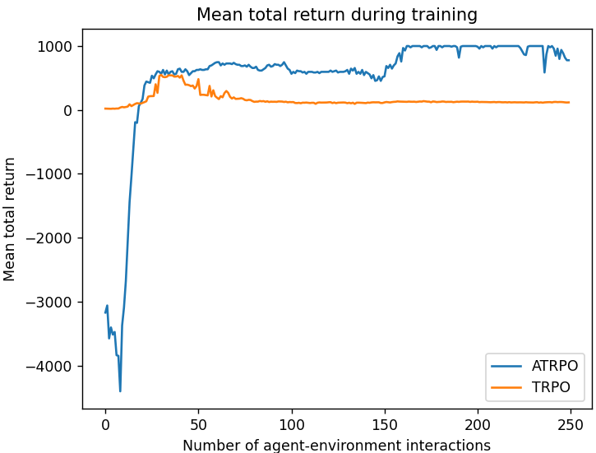
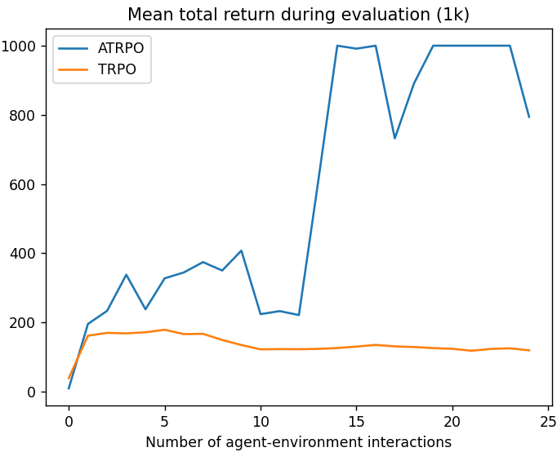
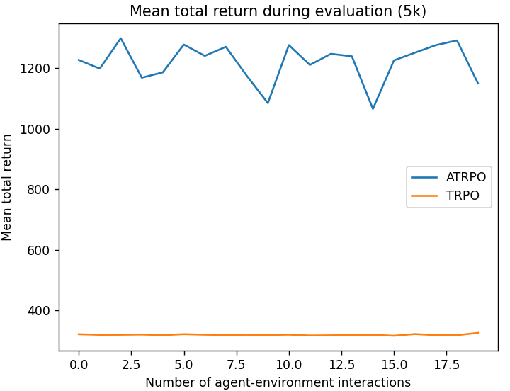
EVALUATION PROTOCOL:
Policy trained for 250 environment steps. Every 10 steps, 5 separate evaluation trajectories were run with the current policy without exploration. For each evaluation trajectory the undiscounted return of the trajectory until the agent falls or until 1,000 steps, whichever comes first, were calculated.
Notes:
Talk about continuous control simulated with negative reward

Slide 28
CONCLUSION
This paper provides a theoretical foundation for extending reinforcement learning algorithms to the average reward setting, which is an important and challenging problem in the field.
The proposed ATRPO algorithm shows promising results.
It can be a valuable tool for solving complex control tasks with continuous state and action spaces.

Slide 29
REFERENCES
Zhang, Y. and Ross, K.W., 2021, July. On-policy deep reinforcement learning for the average-reward criterion. In International Conference on Machine Learning (pp. 12535-12545). PMLR.
Blackwell, D. Discrete dynamic programming. The Annals of Mathematical Statistics, pp. 719–726, 1962.
Schulman, J., Levine, S., Abbeel, P., Jordan, M., and Moritz, P. Trust region policy optimization. In International Conference on Machine Learning, pp. 1889–1897, 2015.
Achiam, J., Held, D., Tamar, A., and Abbeel, P. Constrained policy optimization. In Proceedings of the 34th International Conference on Machine Learning-Volume 70, pp. 22–31. JMLR. org, 2017.
TRPO implementation - https://gist.github.com/elumixor/c16b7bdc38e90aa30c2825d53790d217
TRPO Update Rule - https://spinningup.openai.com/en/latest/_images/math/5808864ea60ebc3702704717d9f4c3773c90540d.svg

Slide 30
THANK YOU!

